Slide 1
The Black-Scholes-Merton Model

Slide 2
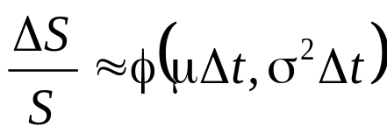
The Stock Price Assumption
Consider a stock whose price is S
In a short period of time of length Δt, the return on the stock is normally distributed:
where μ is expected return and σ is volatility

Slide 3
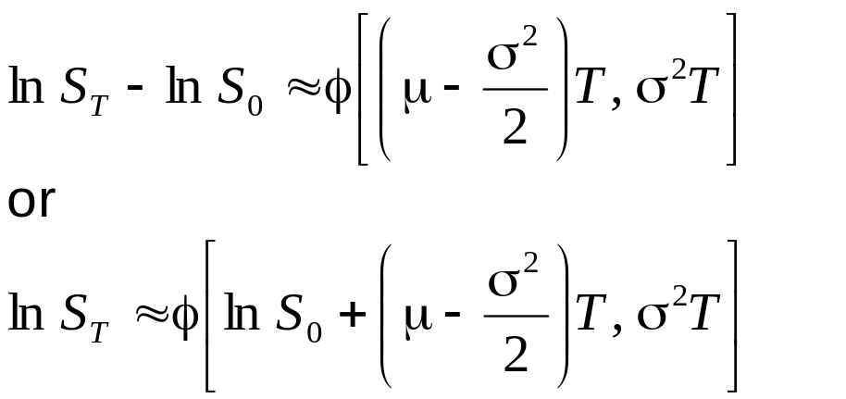
The Lognormal Property
(Equations 13.2 and 13.3, page 278)
It follows from this assumption that
Since the logarithm of S_{T} is normal, S_{T} is lognormally distributed

Slide 4
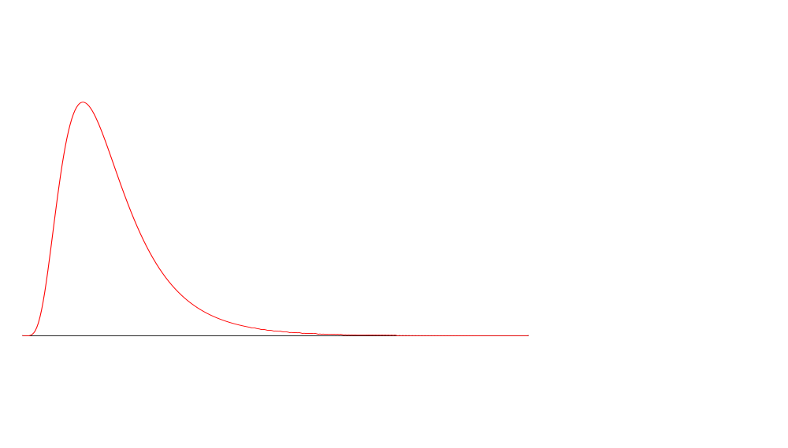
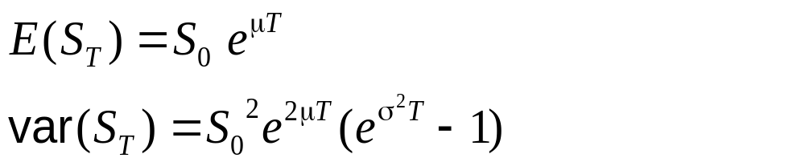
The Lognormal Distribution

Slide 5
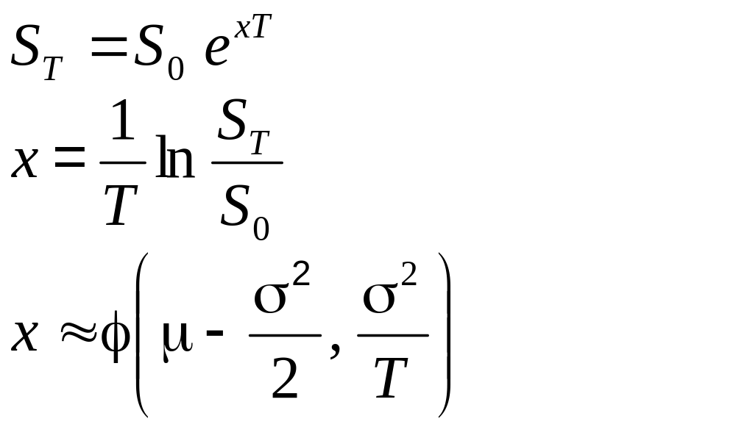
Continuously Compounded Return (Equations 13.6 and 13.7), page 279)
If x is the continuously compounded return

Slide 6
The Expected Return
The expected value of the stock price is S₀e^{μT}
The expected return on the stock is
μ – σ²/2 not μ
This is because
are not the same

Slide 7
μ and μ−σ²/2
Suppose we have daily data for a period of several months
  μ is the average of the returns in each day [=E(ΔS/S)]
  μ−σ²/2 is the expected return over the whole period covered by the data measured with continuous compounding (or daily compounding, which is almost the same)

Slide 8
Mutual Fund Returns (See Business Snapshot 13.1 on page 281)
Suppose that returns in successive years are 15%, 20%, 30%, -20% and 25%
The arithmetic mean of the returns is 14%
The returned that would actually be earned over the five years (the geometric mean) is 12.4%

Slide 9
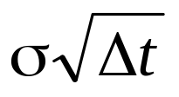
The Volatility
The volatility is the standard deviation of the continuously compounded rate of return in 1 year
The standard deviation of the return in time Δt is
If a stock price is $50 and its volatility is 25% per year what is the standard deviation of the price change in one day?

Slide 10
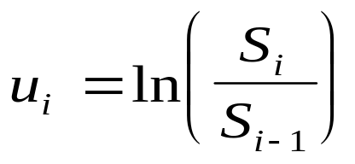
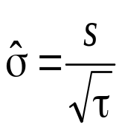
Estimating Volatility from Historical Data (page 282-84)
Take observations S₀, S₁, . . . , S_{n} at intervals of τ years
Calculate the continuously compounded return in each interval as:
Calculate the standard deviation, s , of the u_{i}´s
The historical volatility estimate is:

Slide 11
Nature of Volatility
Volatility is usually much greater when the market is open (i.e. the asset is trading) than when it is closed
For this reason time is usually measured in “trading days” not calendar days when options are valued

Slide 12
The Concepts Underlying Black-Scholes
The option price and the stock price depend on the same underlying source of uncertainty
We can form a portfolio consisting of the stock and the option which eliminates this source of uncertainty
The portfolio is instantaneously riskless and must instantaneously earn the risk-free rate
This leads to the Black-Scholes differential equation

Slide 13
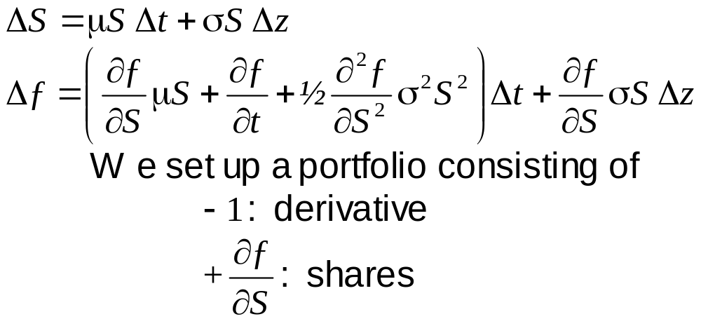
The Derivation of the Black-Scholes Differential Equation

Slide 14
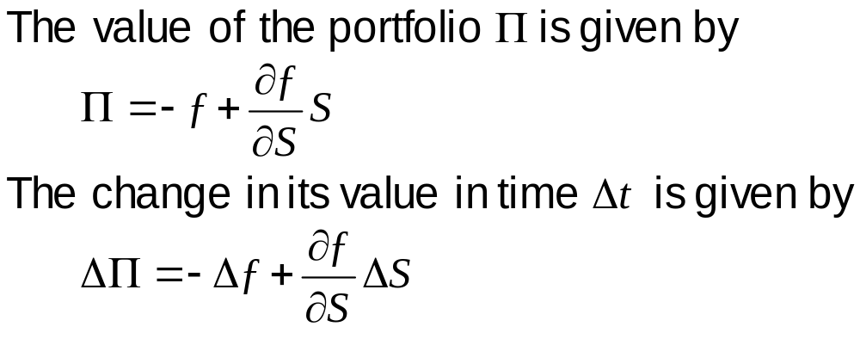
The Derivation of the Black-Scholes Differential Equation continued

Slide 15
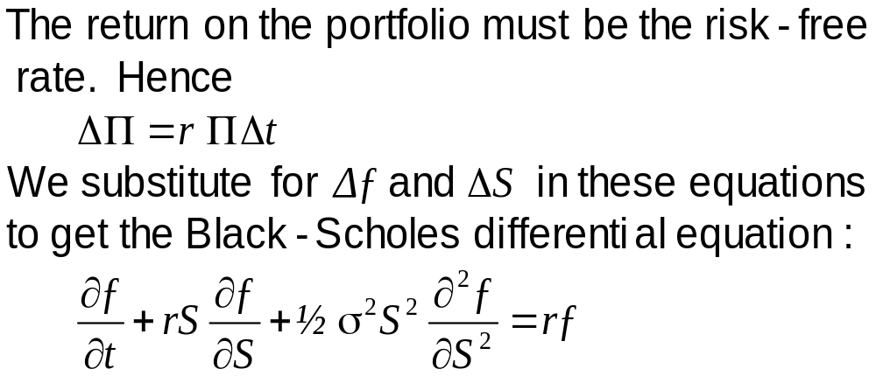
The Derivation of the Black-Scholes Differential Equation continued

Slide 16
The Differential Equation
Any security whose price is dependent on the stock price satisfies the differential equation
The particular security being valued is determined by the boundary conditions of the differential equation
In a forward contract the boundary condition is ƒ = S – K when t =T
The solution to the equation is
ƒ = S – K e^{–r (T – t )}

Slide 17
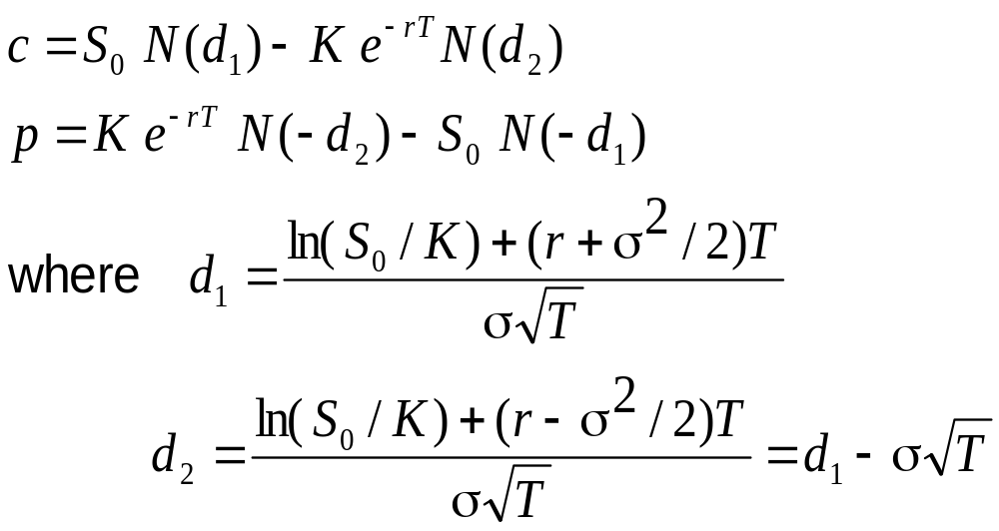
The Black-Scholes Formulas
(See pages 291-293)

Slide 18
The N(x) Function
N(x) is the probability that a normally distributed variable with a mean of zero and a standard deviation of 1 is less than x

Slide 19
Calculate price of call option and put option from the following
The stock price 6 months from the expiration of an option is $42,
the exercise price of the option is $40,
the risk-free interest rate is 10% per annum, and
the volatility is 20% per annum.

Slide 20
Risk-Neutral Valuation
The variable μ does not appear in the Black-Scholes equation
The equation is independent of all variables affected by risk preference
The solution to the differential equation is therefore the same in a risk-free world as it is in the real world
This leads to the principle of risk-neutral valuation

Slide 21
Applying Risk-Neutral Valuation
(See appendix at the end of Chapter 13)
1. Assume that the expected return from the stock price is the risk-free rate
2. Calculate the expected payoff from the option
3. Discount at the risk-free rate

Slide 22
Implied Volatility
The implied volatility of an option is the volatility for which the Black-Scholes price equals the market price
There is a one-to-one correspondence between prices and implied volatilities
Traders and brokers often quote implied volatilities rather than dollar prices

Slide 23
Dividends
European options on dividend-paying stocks are valued by substituting the stock price less the present value of dividends into Black-Scholes
Only dividends with ex-dividend dates during life of option should be included
The “dividend” should be the expected reduction in the stock price expected

